Slide 1

CISC360 Computer Architecture
Lesson 16
Fault-Tolerance
Slides courtesy of Jim Gray, Microsoft Research

Slide 2

The Airplane Rule
“A two engine airplane has twice as many engine problems.”
“A thousand-engine airplane has thousands of engine problems.”
Fault Tolerance is KEY!
Mask and repair faults
Internet: Node fails every 2 weeks
Vendors: Disk fails every 40 years
Here: node “fails” every 20 minutes
disk fails every 2 weeks.
100 Tape Transports
= 1,000 tapes = 1 PetaByte
1,000 discs =
10 Terrorbytes
100 Nodes
1 Tips
High Speed Network ( 10 Gb/s)

Slide 3
Outline
Does fault tolerance work?
General methods to mask faults.
Software-fault tolerance
Summary

Slide 4
DEPENDABILITY: The 3 ITIES
RELIABILITY / INTEGRITY:
Does the right thing
(also large MTTF)
AVAILABILITY: Does it now.
(also large MTTF
MTTF+MTTR
System Availability:
If 90% of terminals up & 99% of DB up?
(=>89% of transactions are serviced on time)
Integrity /
Security
Security
Integrity /
Reliability
Reliability
Availability
Availability

Slide 5
High Availability System Classes
Goal: Build Class 6 Systems
System Type
Unmanaged
Managed
Well Managed
Fault Tolerant
High-Availability
Very-High-Availability
Ultra-Availability
Unavailable
(min/year)
50,000
5,000
500
50
5
.5
.05
Availability
90.%
99.%
99.9%
99.99%
99.999%
99.9999%
99.99999%
Availability
Class
1
2
3
4
5
6
7

Slide 6
Sources of Failures
MTTF MTTR
Power Failure: 2000 hr 1 hr
Phone Lines
Soft >.1 hr .1 hr
Hard 4000 hr 10 hr
Hardware Modules: 100,000hr 10hr (many are transient)
Software:
1 Bug/1000 Lines Of Code (after vendor-user testing)
=> Thousands of bugs in System!
Most software failures are transient: dump & restart system.
Useful fact: 8,760 hrs/year ~ 10k hr/year

Slide 7
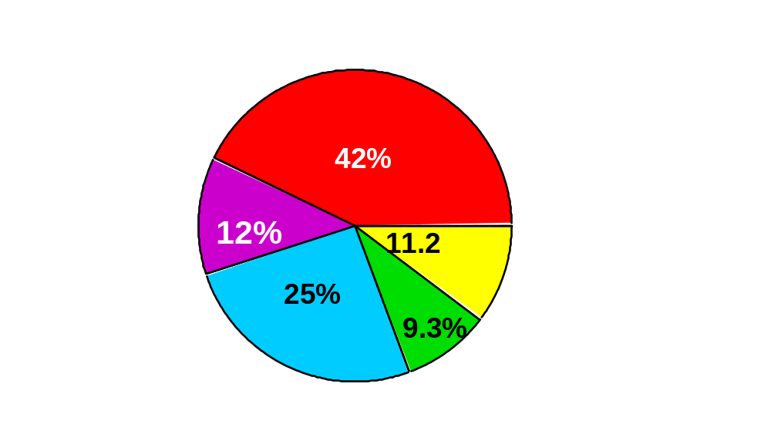
Case Studies - Japan
"Survey on Computer Security",
Japan Info Dev Corp., March 1986.
Vendor (hardware and software) 5 Months
Application software 9 Months
Communications lines 1.5 Years
Operations 2 Years
Environment 2 Years
10 Weeks
1,383 institutions reported (6/84 - 7/85)
7,517 outages, MTTF ~ 10 weeks, avg duration ~ 90 MINUTES
TO GET 10 YEAR MTTF
MUST ATTACK ALL THESE AREAS

Slide 8
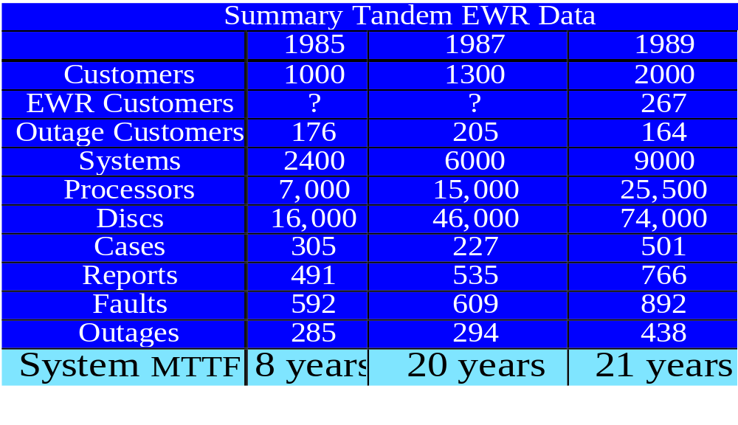
Case Studies -Tandem
Outage Reports to Vendor
Totals:
More than 7,000 Customer years
More than 30,000 System years
More than 80,000 Processor years
More than 200,000 Disc Years
Systematic Under-reporting
But ratios & trends interesting

Slide 9
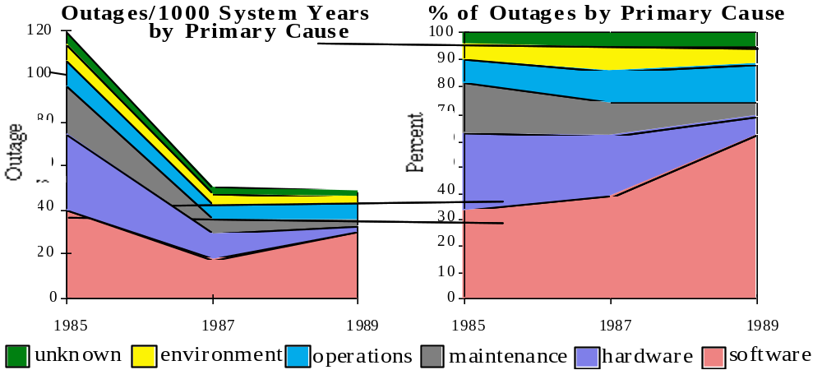
Case Studies - Tandem Trends
MTTF improved: WOW! Outages per millennium.
Shift from Hardware & Maintenance to from 50% to 10%
to Software (62%) & Operations (15%)
NOTE: Systematic under-reporting of Environment
Operations errors
Application Software

Slide 10
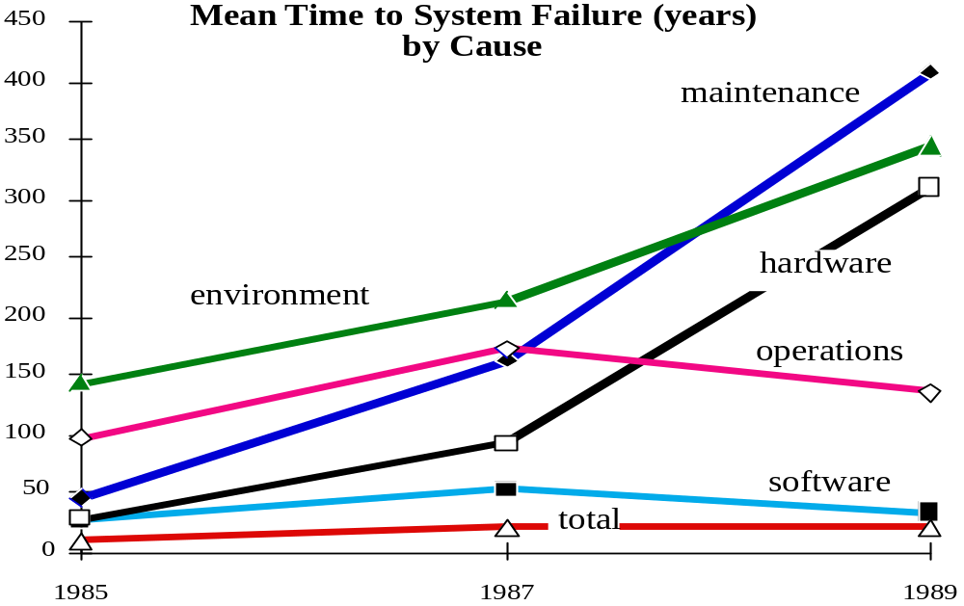
Case Studies - Tandem Trends
Reported MTTF by Component
1985 1987 1990
SOFTWARE 2 53 33 Years
HARDWARE 29 91 310 Years
MAINTENANCE 45 162 409 Years
OPERATIONS 99 171 136 Years
ENVIRONMENT 142 214 346 Years
SYSTEM 8 20 21 Years
Remember Systematic Under-reporting

Slide 11
Summary
Current Situation: ~4-year MTTF => Fault Tolerance Works.
Hardware is GREAT (maintenance and MTTF).
Software masks most hardware faults.
Many hidden software outages in operations:
  New System Software.
  New Application Software.
  Utilities.
Must make all software ONLINE.
Software seems to define a 30-year MTTF ceiling.
Reasonable Goal:
100-year MTTF.
class 4 today => class 6 tomorrow.

Slide 12
Outline
Does fault tolerance work?
General methods to mask faults.
Software-fault tolerance
Summary

Slide 13
Key Idea
{
}
{
}
Architecture Hardware Faults
Software Masks Environmental Faults
Distribution Maintenance
Software automates / eliminates operators
So,
In the limit there are only software & design faults.
Software-fault tolerance is the key to dependability.
INVENT IT!

Slide 14
Fault Tolerance Techniques
FAIL FAST MODULES: work or stop
SPARE MODULES : instant repair time.
INDEPENDENT MODULE FAILS by design
MTTF_{Pair} ~ MTTF²/ MTTR (so want tiny MTTR)
MESSAGE BASED OS: Fault Isolation
software has no shared memory.
SESSION-ORIENTED COMM: Reliable messages
detect lost/duplicate messages
coordinate messages with commit
PROCESS PAIRS :Mask Hardware & Software Faults
TRANSACTIONS: give A.C.I.D. (simple fault model)

Slide 15
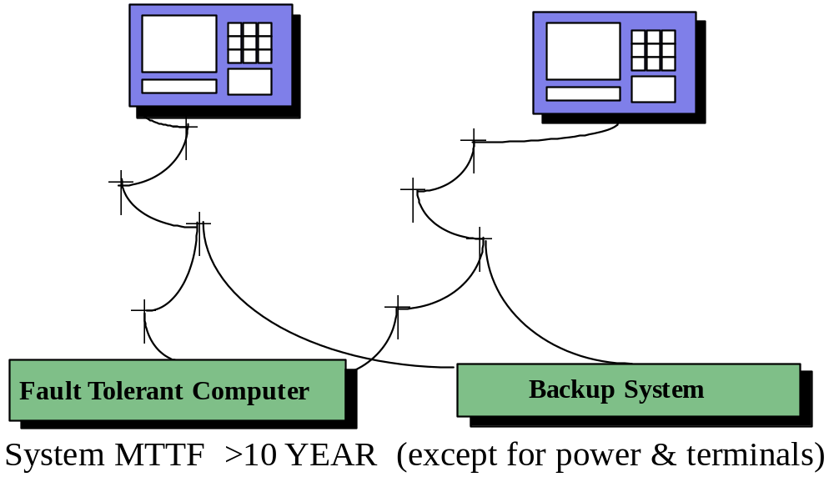
Example: the FT Bank
Modularity & Repair are KEY:
vonNeumann needed 20,000x redundancy in wires and switches
We use 2x redundancy.
Redundant hardware can support peak loads (so not redundant)

Slide 16
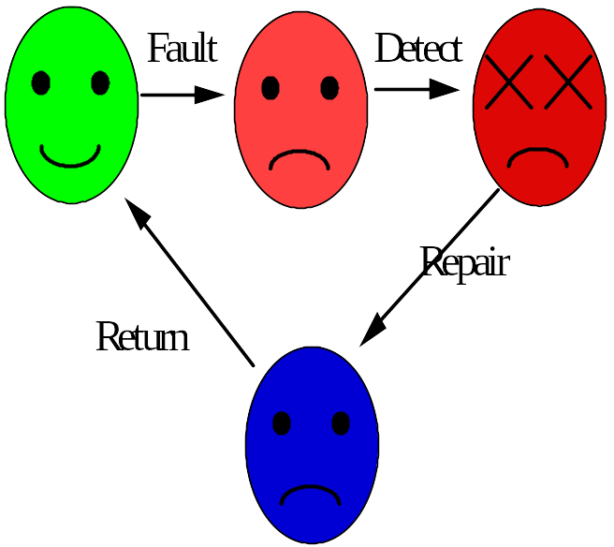
Fail-Fast is Good, Repair is Needed
Lifecycle of a module
fail-fast gives
short fault latency
High Availability
is low UN-Availability
Unavailability ­ ^{MTTR}
MTTF
Improving either MTTR or MTTF gives benefit
Simple redundancy does not help much.

Slide 17
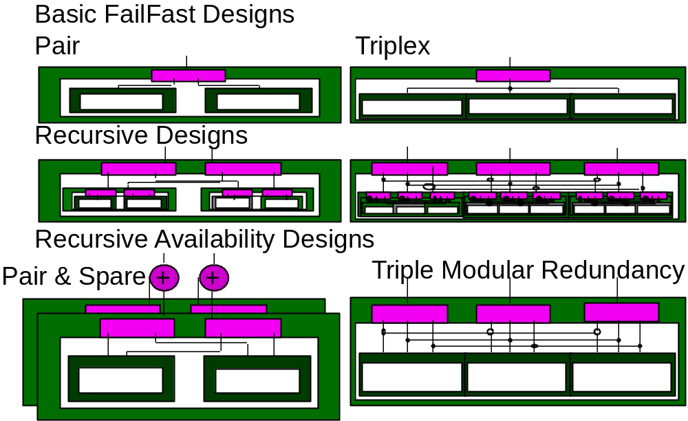
Hardware Reliability/Availability
(how to make it fail fast)
Comparator Strategies:
Duplex: Fail-Fast: fail if either fails (e.g. duplexed cpus)
vs Fail-Soft: fail if both fail (e.g. disc, atm,...)
Note: in recursive pairs, parent knows which is bad.
Triplex: Fail-Fast: fail if 2 fail (triplexed cpus)
Fail-Soft: fail if 3 fail (triplexed FailFast cpus)

Slide 18
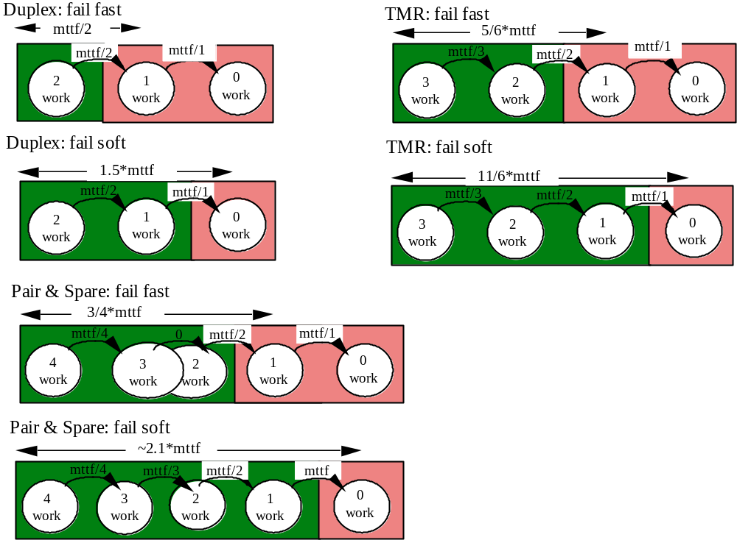
Redundant Designs have Worse MTTF!
THIS IS NOT GOOD: Variance is lower but MTTF is worse
Simple redundancy does not improve MTTF (sometimes hurts).
This is just an example of the airplane rule.

Slide 19
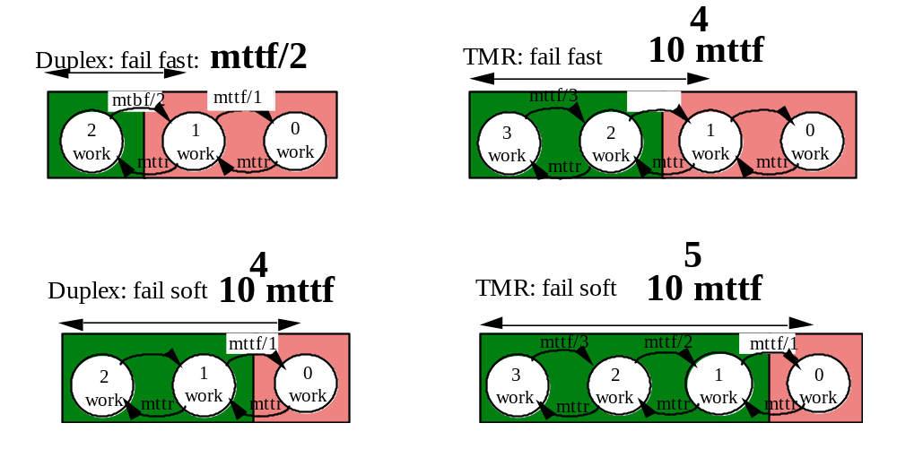
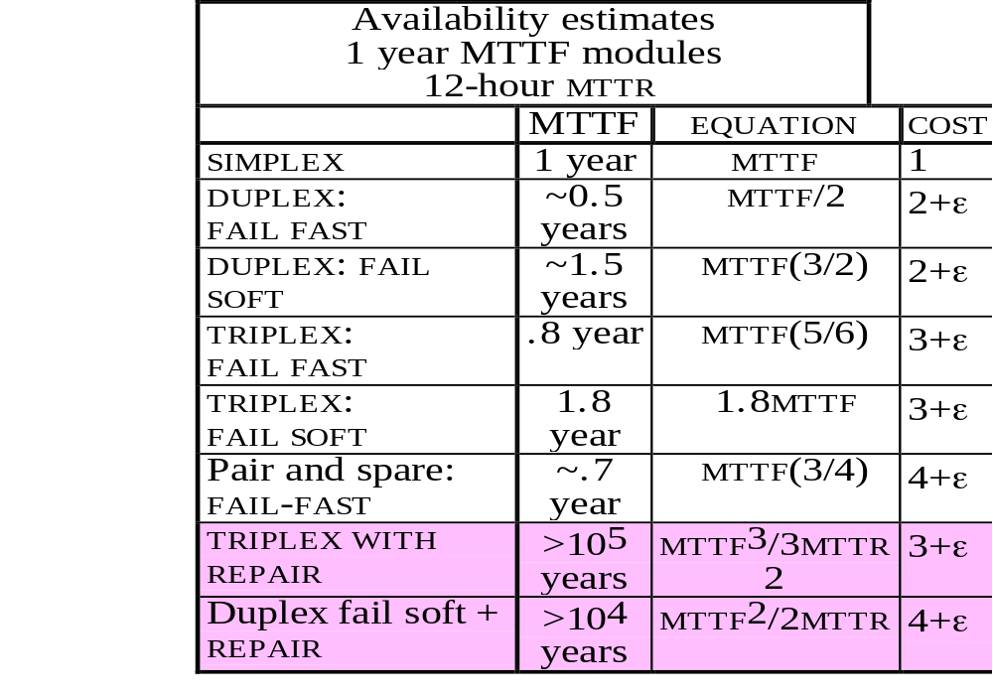
Add Repair: Get 10⁴ Improvement

Slide 20
When To Repair?
Chances Of Tolerating A Fault are 1000:1 (class 3)
A 1995 study: Processor & Disc Rated At ~ 10khr MTTF
Computed Single Observed
Failures Double Fails Ratio
10k Processor Fails 14 Double ~ 1000 : 1
40k Disc Fails, 26 Double ~ 1000 : 1
Hardware Maintenance:
On-Line Maintenance "Works" 999 Times Out Of 1000.
The chance a duplexed disc will fail during maintenance?1:1000
Risk Is 30x Higher During Maintenance
=> Do It Off Peak Hour
Software Maintenance:
Repair Only Virulent Bugs
Wait For Next Release To Fix Benign Bugs

Slide 21
OK: So Far
Hardware fail-fast is easy
Redundancy plus Repair is great (Class 7 availability)
Hardware redundancy & repair is via modules.
How can we get instant software repair?
We Know How To Get Reliable Storage
RAID Or Dumps And Transaction Logs.
We Know How To Get Available Storage
Fail Soft Duplexed Discs (RAID 1...N).
? HOW DO WE GET RELIABLE EXECUTION?
? HOW DO WE GET AVAILABLE EXECUTION?

Slide 22
Outline
Does fault tolerance work?
General methods to mask faults.
Software-fault tolerance
Summary

Slide 23
Software Techniques:
Learning from Hardware
Recall that most outages are not hardware.
Most outages in Fault Tolerant Systems are SOFTWARE
Fault Avoidance Techniques: Good & Correct design.
After that: Software Fault Tolerance Techniques:
Modularity (isolation, fault containment)
Design diversity
N-Version Programming: N-different implementations
Defensive Programming: Check parameters and data
Auditors: Check data structures in background
Transactions: to clean up state after a failure
Paradox: Need Fail-Fast Software

Slide 24
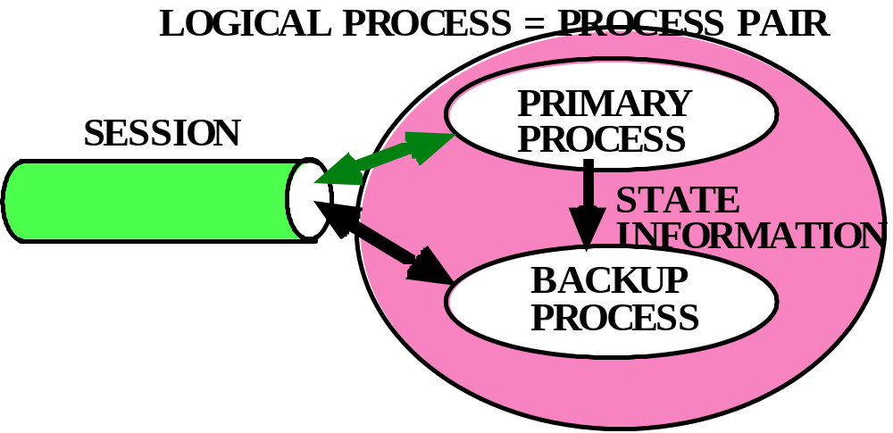
Fail-Fast /
High-Availability
Execution
Software N-Plexing: Design Diversity
N-Version Programming
Write the same program N-Times (N > 3)
Compare outputs of all programs and take majority vote
Process Pairs: Instant restart (repair)
Use Defensive programming to make a process fail-fast
Have restarted process ready in separate environment
Second process “takes over” if primary faults
Transaction mechanism can clean up distributed state
if takeover in middle of computation.

Slide 25
What Is MTTF of N-Version Program?
First fails after MTTF/N
Second fails after MTTF/(N-1),...
so MTTF(1/N + 1/(N-1) + ... + 1/2)
harmonic series goes to infinity, but VERY slowly
for example 100-version programming gives
~4 MTTF of 1-version programming
Reduces variance
N-Version Programming Needs REPAIR
If a program fails, must reset its state from other programs.
=> programs have common data/state representation.
How does this work for Database Systems?
Operating Systems?
Network Systems?
Answer: I don’t know.

Slide 26
Why Process Pairs Mask Faults
Many Software Faults are Soft
After Design Review
Code Inspection
Alpha Test
Beta Test
10k Hrs Of Gamma Test (Production)
Most Software Faults Are Transient
MVS Functional Recovery Routines 5:1
Tandem Spooler 100:1
Adams >100:1
Terminology:
Heisenbug: Works On Retry
Bohrbug: Faults Again On Retry

Slide 27
Process Pair Repair Strategy
If software fault (bug) is a Bohrbug, then there is no repair
“wait for the next release” or
“get an emergency bug fix” or
“get a new vendor”
If software fault is a Heisenbug, then repair is
reboot and retry or
switch to backup process (instant restart)
PROCESS PAIRS Tolerate Hardware Faults
Heisenbugs
Repair time is seconds, could be mili-seconds if time is critical
Flavors Of Process Pair: Lockstep
Automatic
State Checkpointing
Delta Checkpointing
Persistent

Slide 28
How Takeover Masks Failures
Server Resets At Takeover But What About
Application State?
Database State?
Network State?
Answer: Use Transactions To Reset State!
Abort Transaction If Process Fails.
Keeps Network "Up"
Keeps System "Up"
Reprocesses Some Transactions On Failure

Slide 29
PROCESS PAIRS - SUMMARY
Transactions Give Reliability
Process Pairs Give Availability
Process Pairs Are Expensive & Hard To Program
Transactions + Persistent Process Pairs
=> Fault Tolerant Sessions Execution
When Tandem Converted To This Style
Saved 3x Messages
Saved 5x Message Bytes
Made Programming Easier

Slide 30
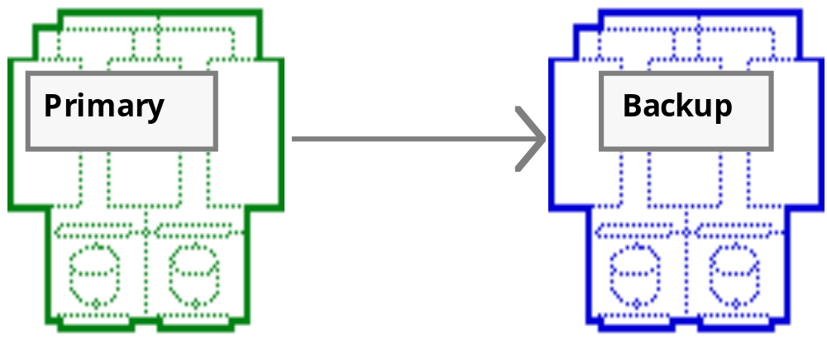
SYSTEM PAIRS
FOR HIGH AVAILABILITY
Programs, Data, Processes Replicated at two sites.
Pair looks like a single system.
System becomes logical concept
Like Process Pairs: System Pairs.
Backup receives transaction log (spooled if backup down).
If primary fails or operator Switches, backup offers service.

Slide 31
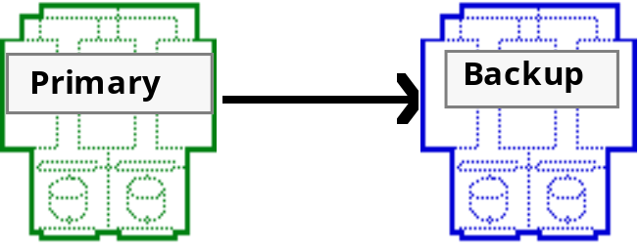
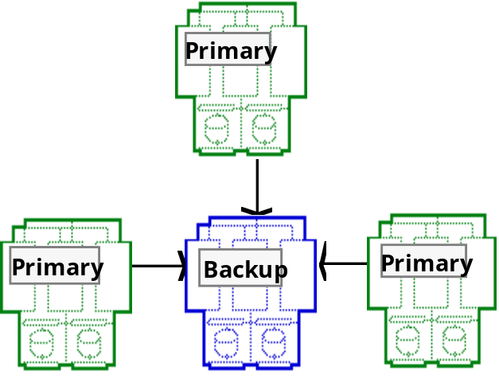
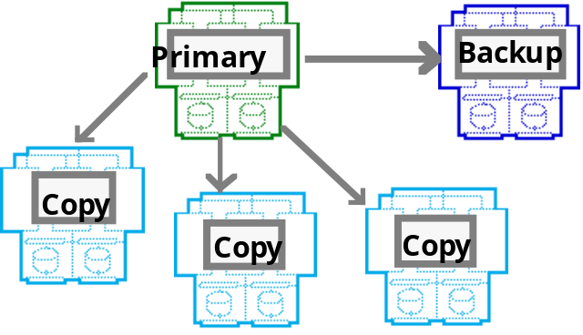
SYSTEM PAIR CONFIGURATION OPTIONS
Mutual Backup:
each has 1/2 of Database & Application
Hub:
One site acts as backup for many others
In General can be any directed graph
Stale replicas: Lazy replication

Slide 32
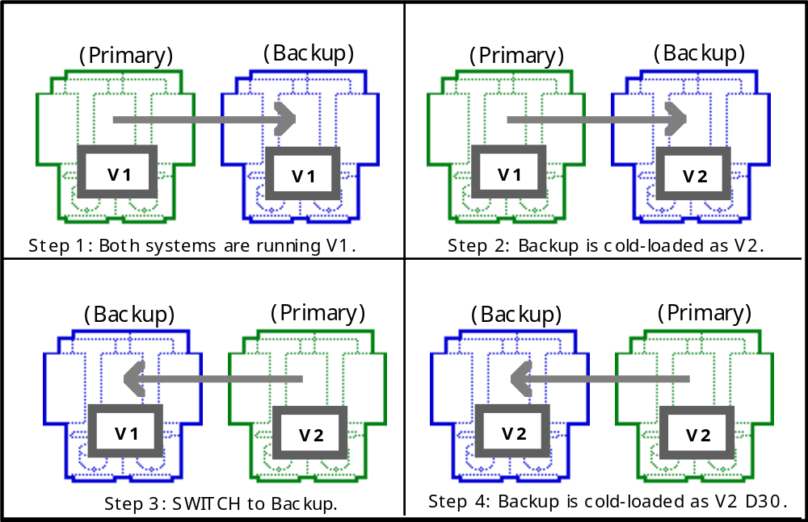
SYSTEM PAIRS FOR: SOFTWARE MAINTENANCE
Similar ideas apply to:
Database Reorganization
Hardware modification (e.g. add discs, processors,...)
Hardware maintenance
Environmental changes (rewire, new air conditioning)
Move primary or backup to new location.

Slide 33
SYSTEM PAIR BENEFITS
Protects against ENVIRONMENT: different sites
weather
utilities
sabotage
Protects against OPERATOR FAILURE:
two sites, two sets of operators
Protects against MAINTENANCE OUTAGES
work on backup
software/hardware install/upgrade/move...
Protects against HARDWARE FAILURES
backup takes over
Protects against TRANSIENT SOFTWARE ERRORS
Commercial systems: Digital's Remote Transaction Router (RTR)
Tandem's Remote Database Facility (RDF)
IBM's Cross Recovery XRF( both in same campus)
Oracle, Sybase, Informix, Microsoft... replication

Slide 34
SUMMARY
FT systems fail for the conventional reasons
Environment mostly
People sometimes
Software mostly
Hardware Rarely
MTTF of FT SYSTEMS ~ 50X conventional
~ years vs weeks
Fail-Fast Modules + Reconfiguration + Repair =>
Good Hardware Fault Tolerance
Transactions + Process Pairs =>
Good Software Fault Tolerance (Repair)
System Pairs Hide Many Faults
Challenge: Tolerate Human Errors
(make system simpler to manage, operate, and maintain)

